Slide 1
NGS
Jong-So ‘Bellbull’ Kim

Slide 2
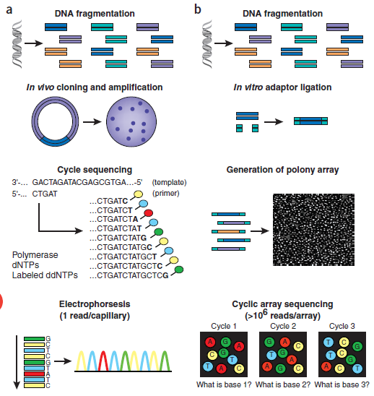
CES vs. NGS
Sanger Sequencing
Plasmid vector and E.Coli used
Each round of primer extension is stochastically terminated by the fluorescently labeled ddNTPs.
Cyclic Array Sequencing

Slide 3
CES vs. NGS
 | CES | NGS
Read Number | 96 or 384 capillaries (limited parallelism) | ~12 billion/run (HiSeq X)
Read Length | Long (~1,000bp) | Short (50~700bp)
Accuracy | ~99.999% | 10 folds less
Cost | $5/rxn (1kb) | As low as $10/Gb
Advantages | Better for small-scale projects (Kb) High accuracy | Cost competitive and practical: technology of choice for large-scale projects In vitro construction of sequencing libraries Low effective reagent volume

Slide 4
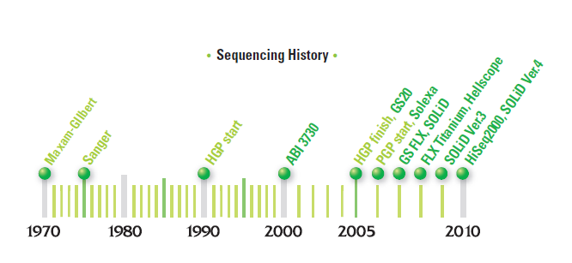
NGS Services
4

Slide 5

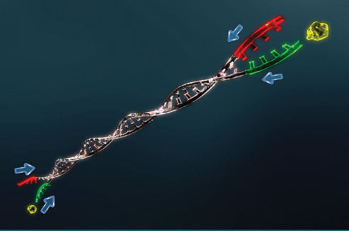
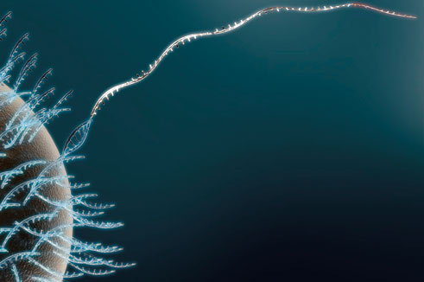
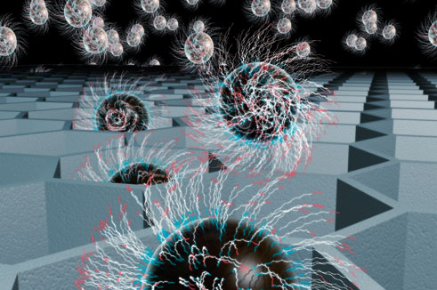
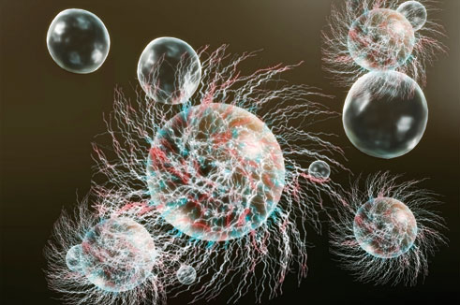
Roche GS FLX 454 Workflow
One Fragment = One Bead = One Read
Sample input & fragmentation
Library preparation & adaptor ligation
Attachment of library to beads
Pyrosequencing
Sequencing in PicoTiterPlate
Emulsion PCR amplification

Slide 6
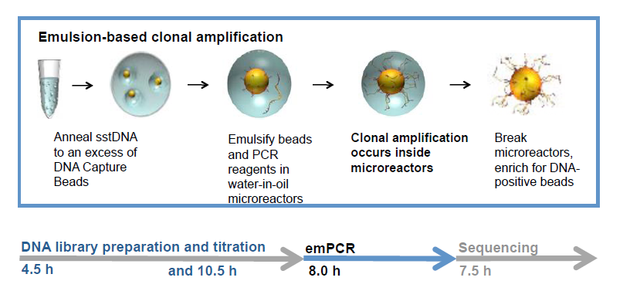
emPCR

Slide 7
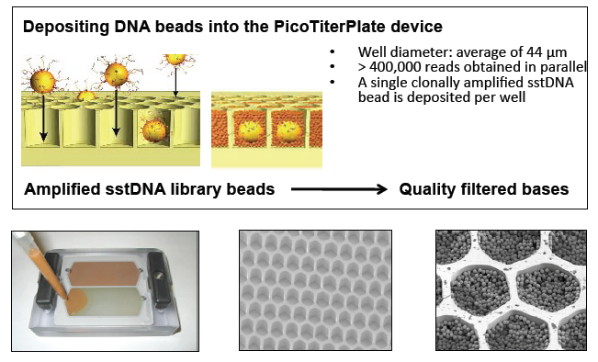
PicoTiterPlate
7

Slide 8
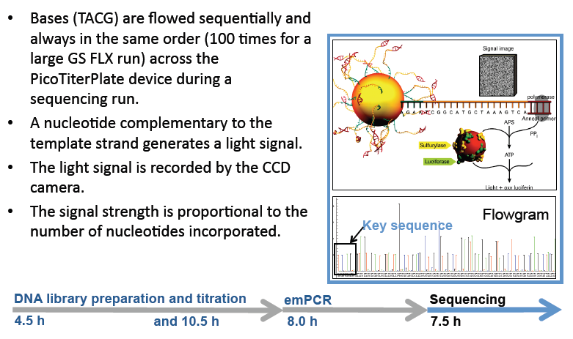
SBS (Sequencing By Synthesis)

Slide 9
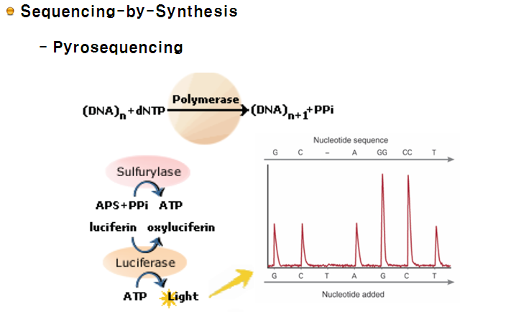
SBS
9

Slide 10
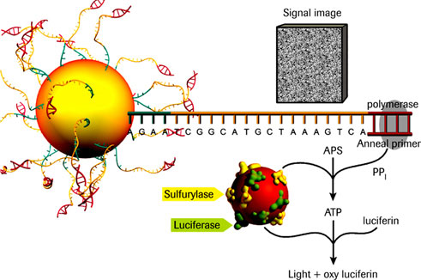
Pyrosequencing Chemistry

Slide 11
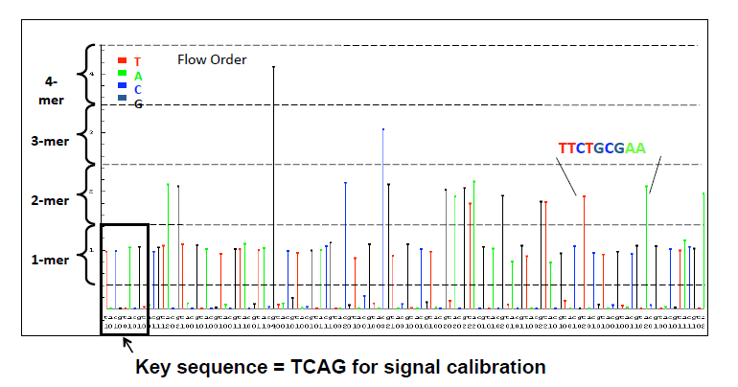
Flowgram Generation
11

Slide 12
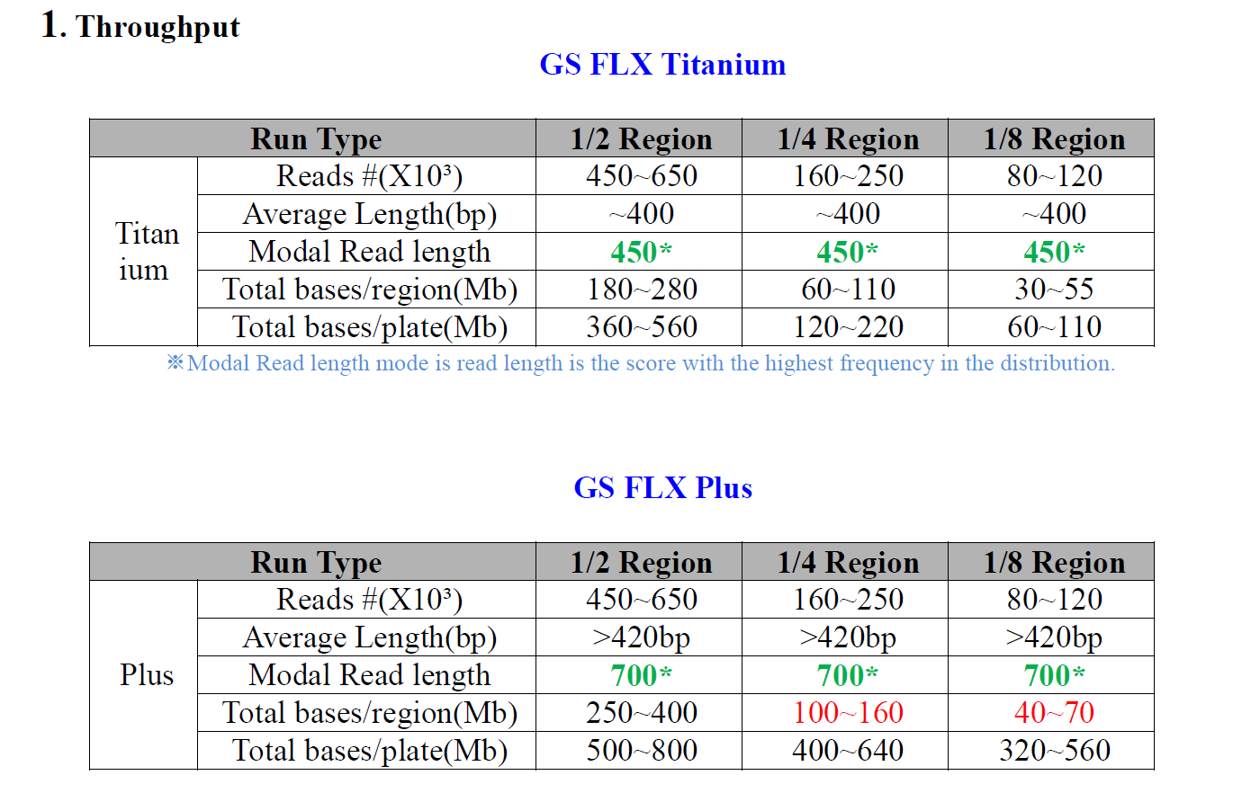
Roche GS FLX 454 Throughput

Slide 13
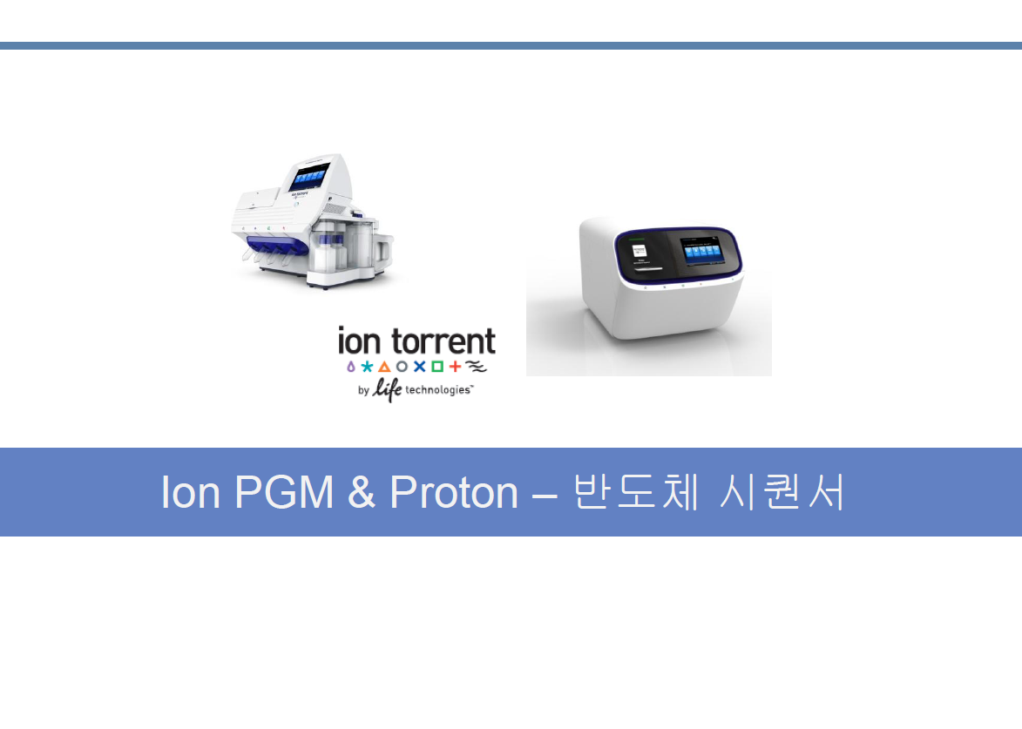

Slide 14
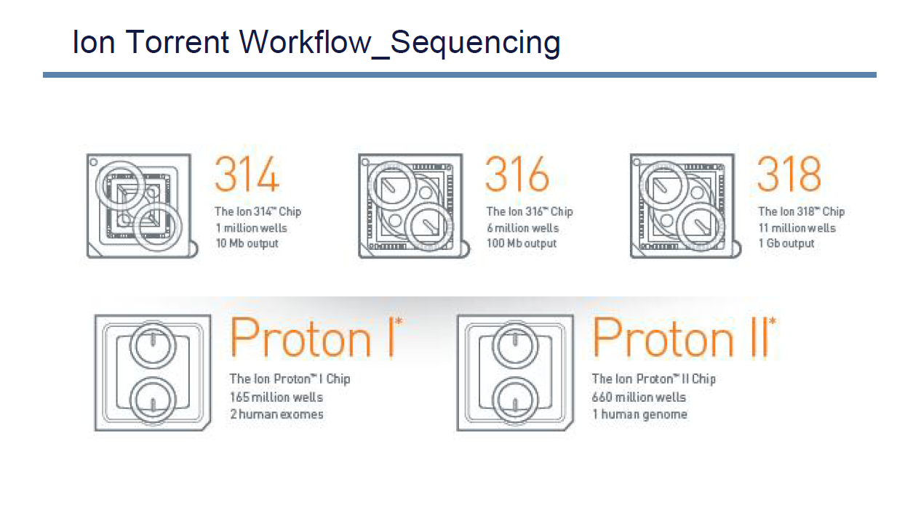

Slide 15
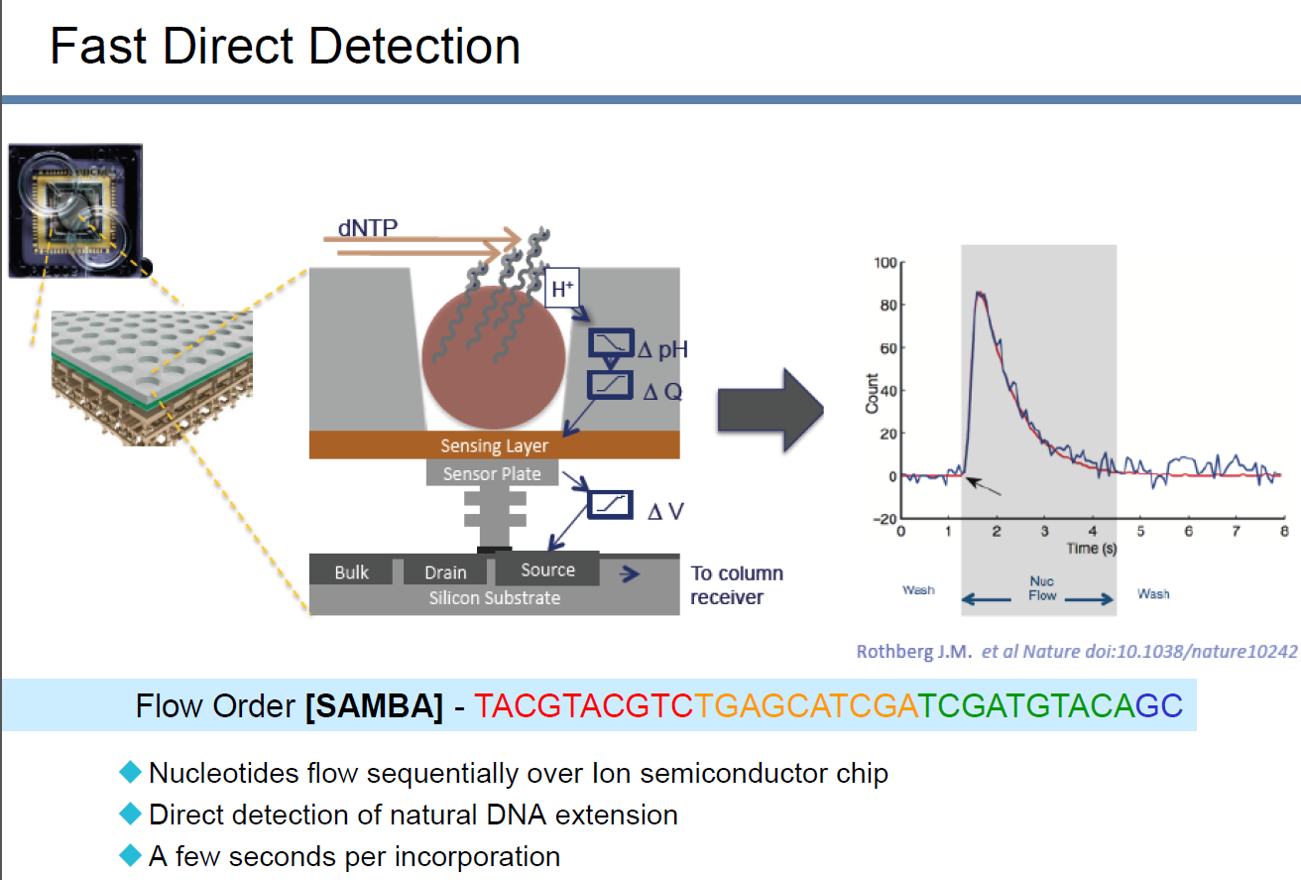

Slide 16
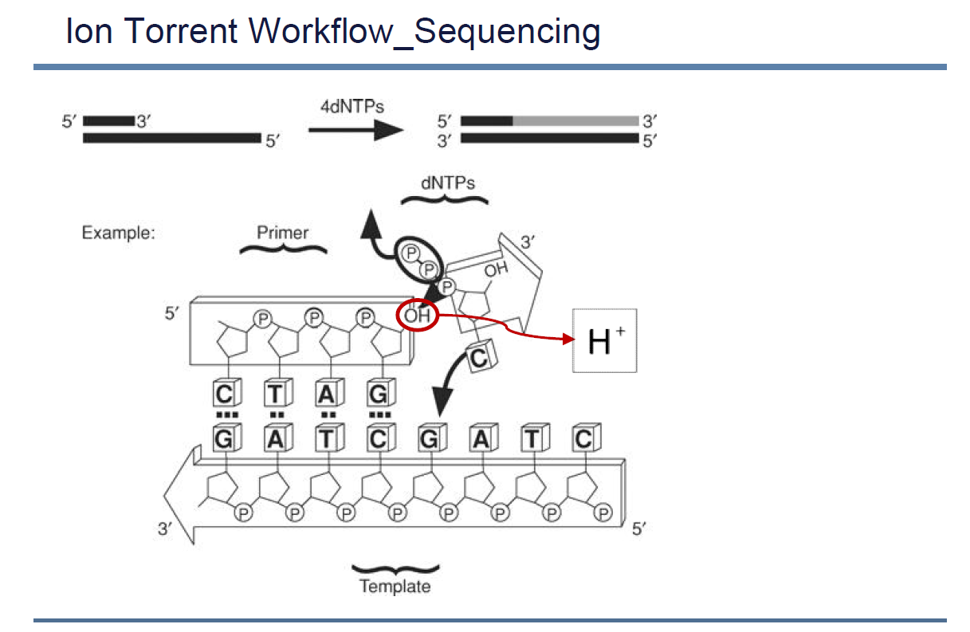

Slide 17
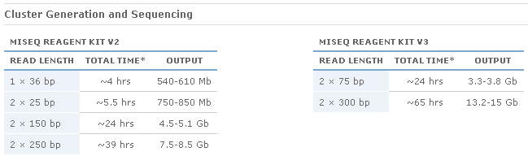
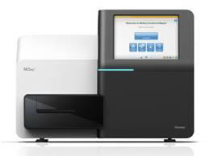
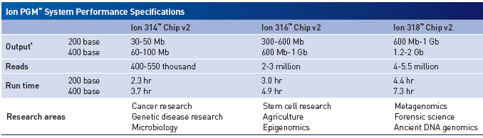
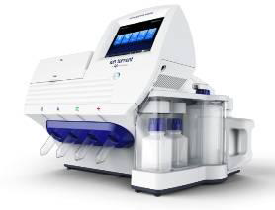

Slide 18
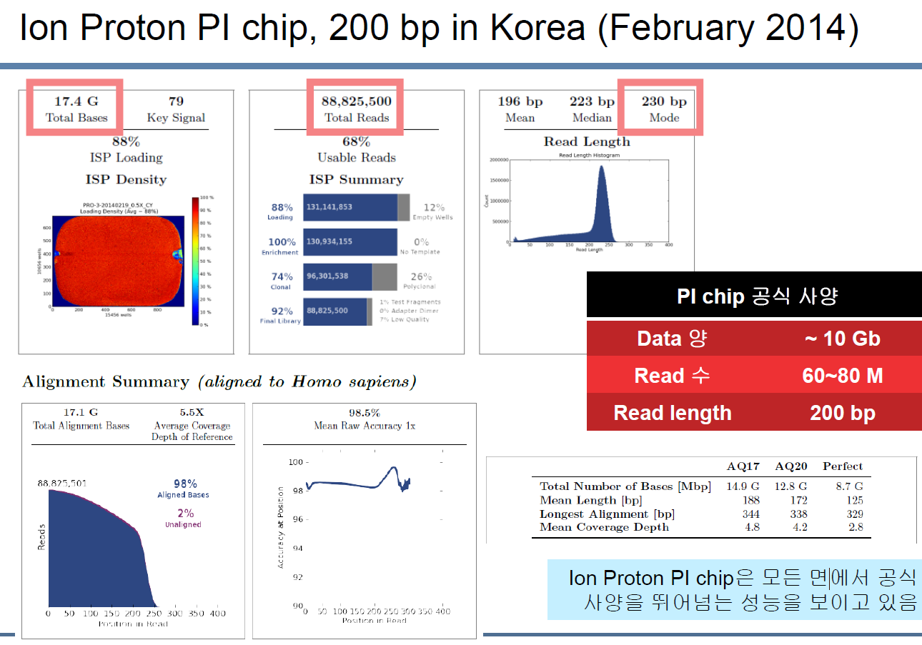

Slide 19
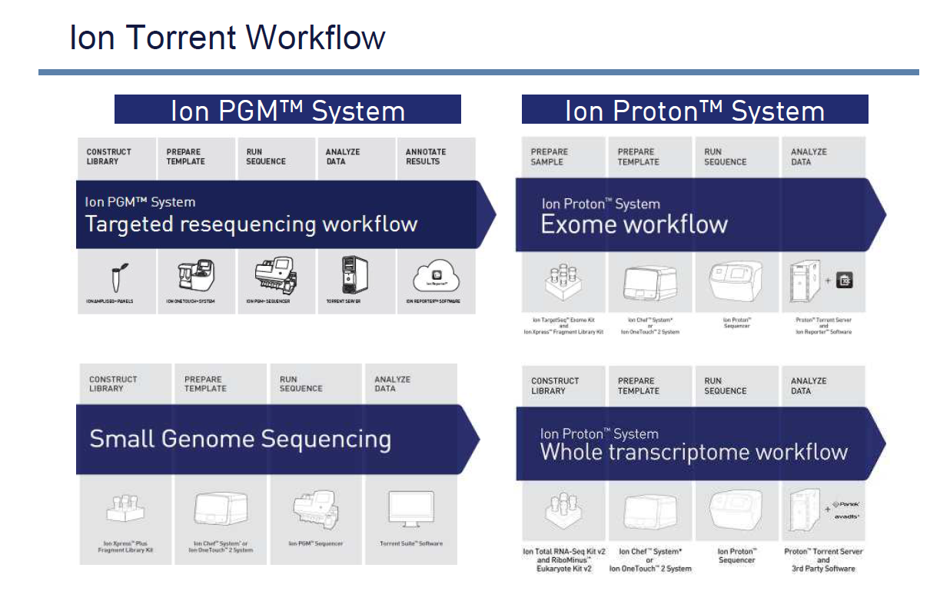

Slide 20
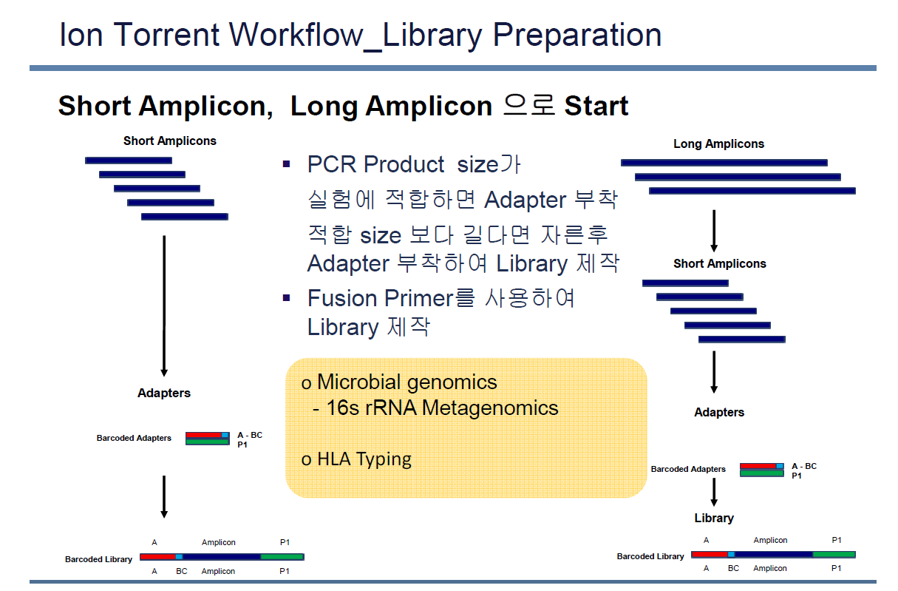

Slide 21
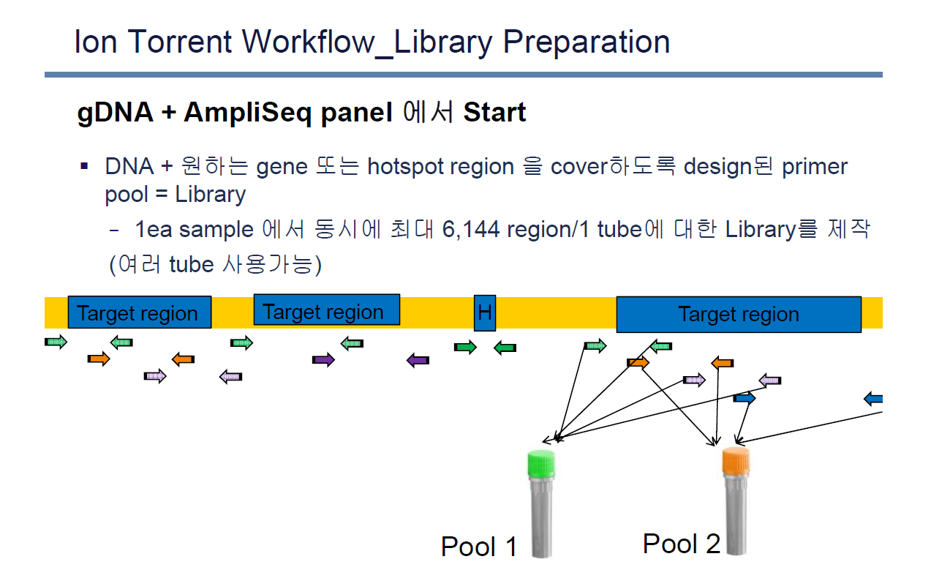

Slide 22
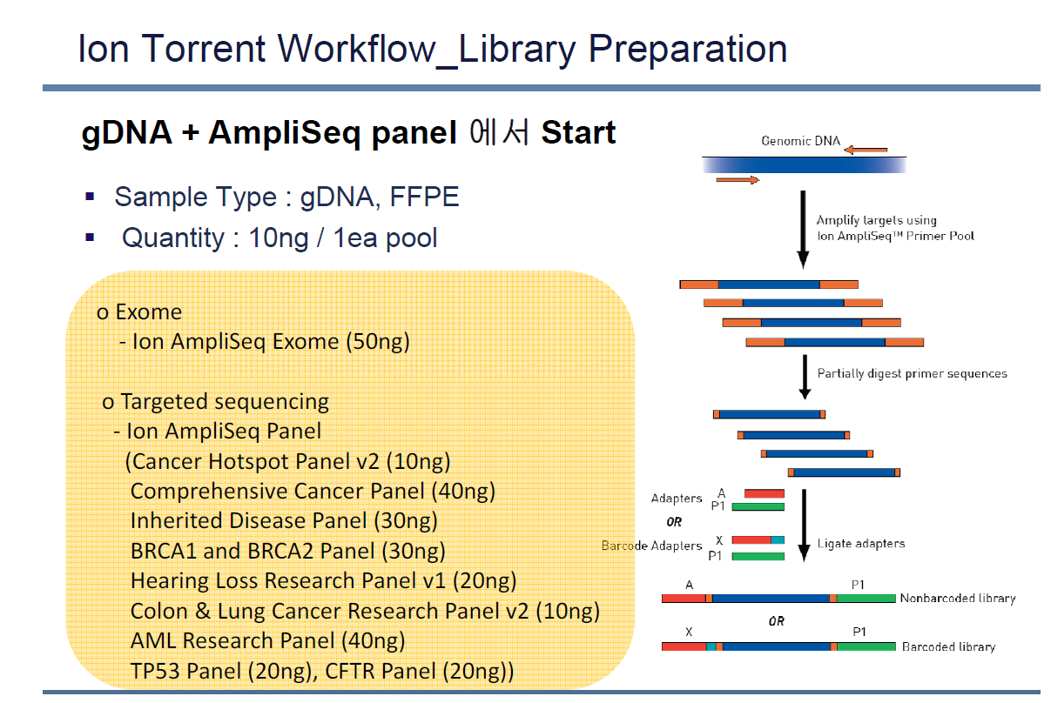

Slide 23
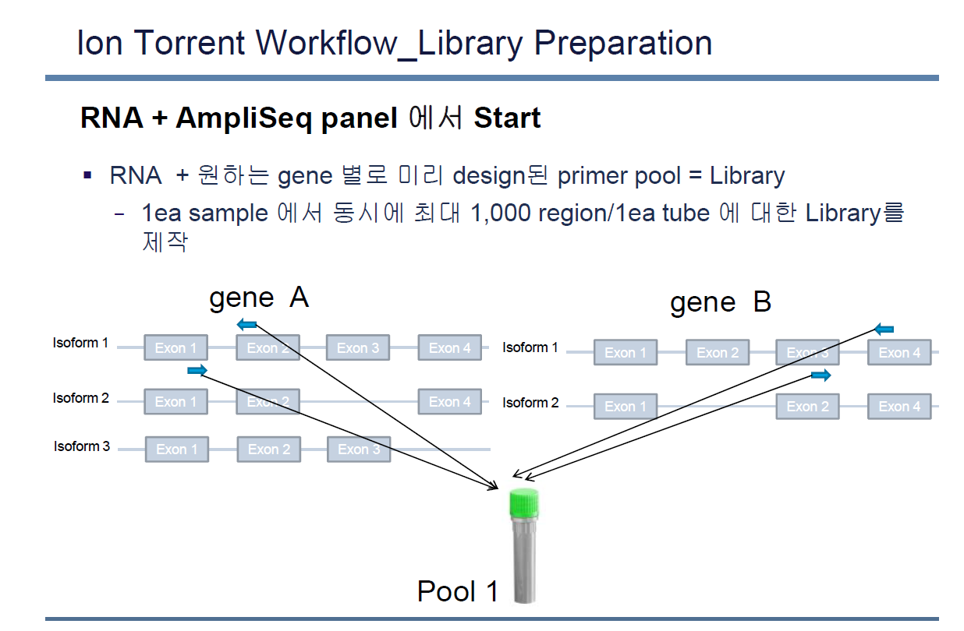

Slide 24
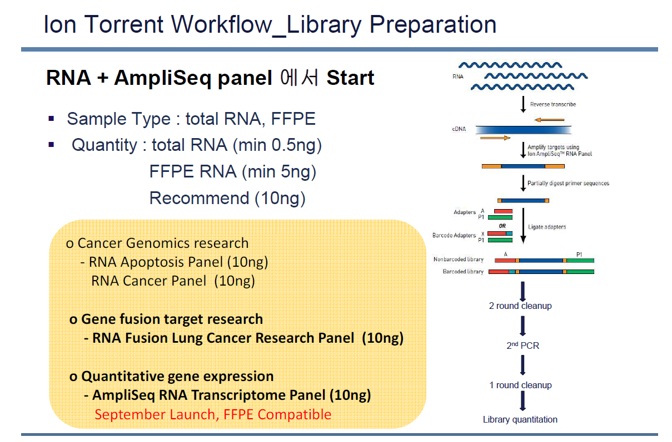

Slide 25
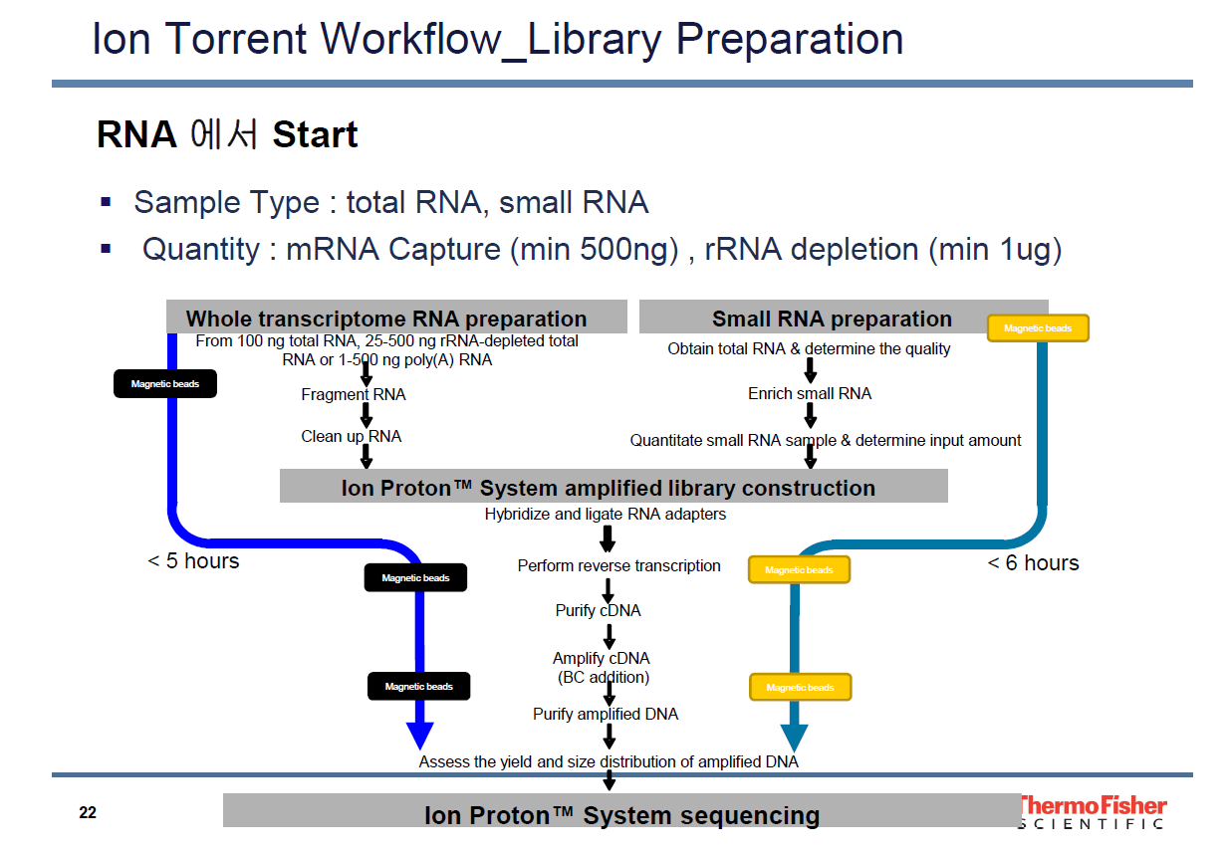

Slide 26
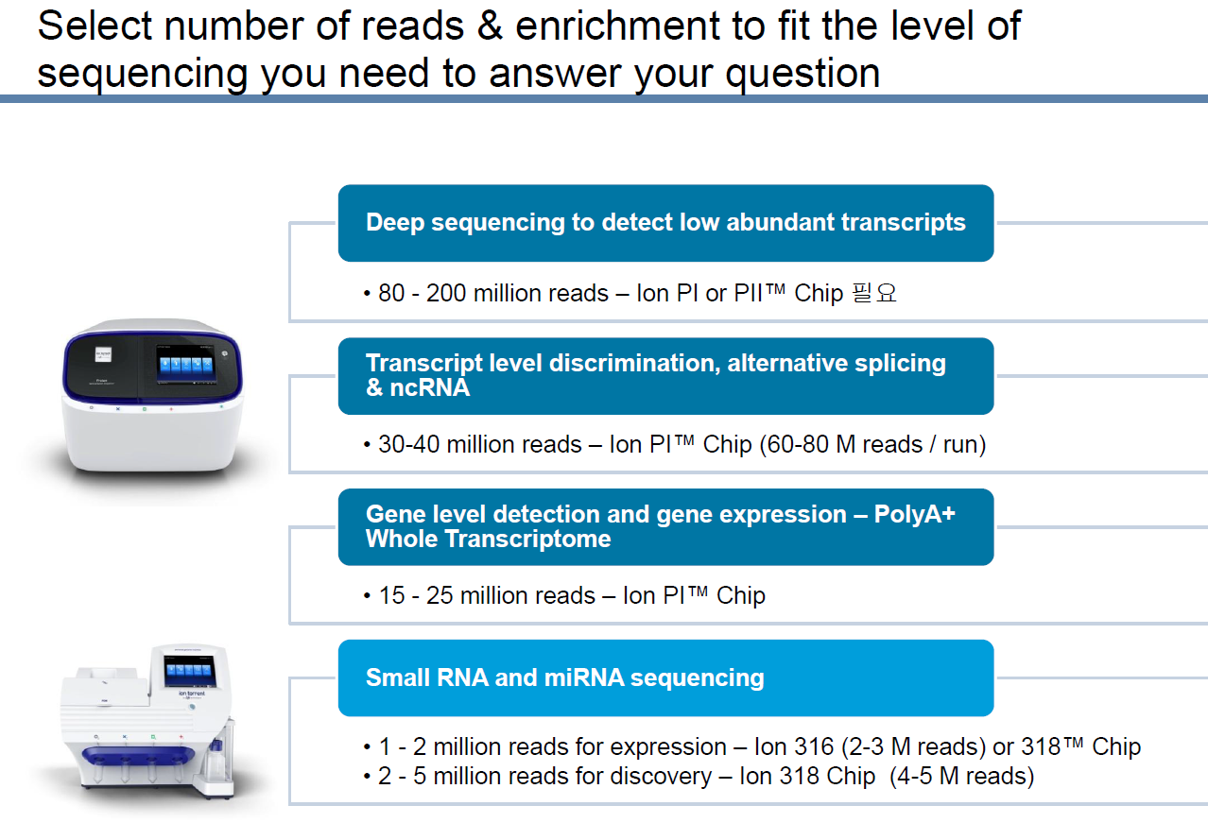

Slide 27
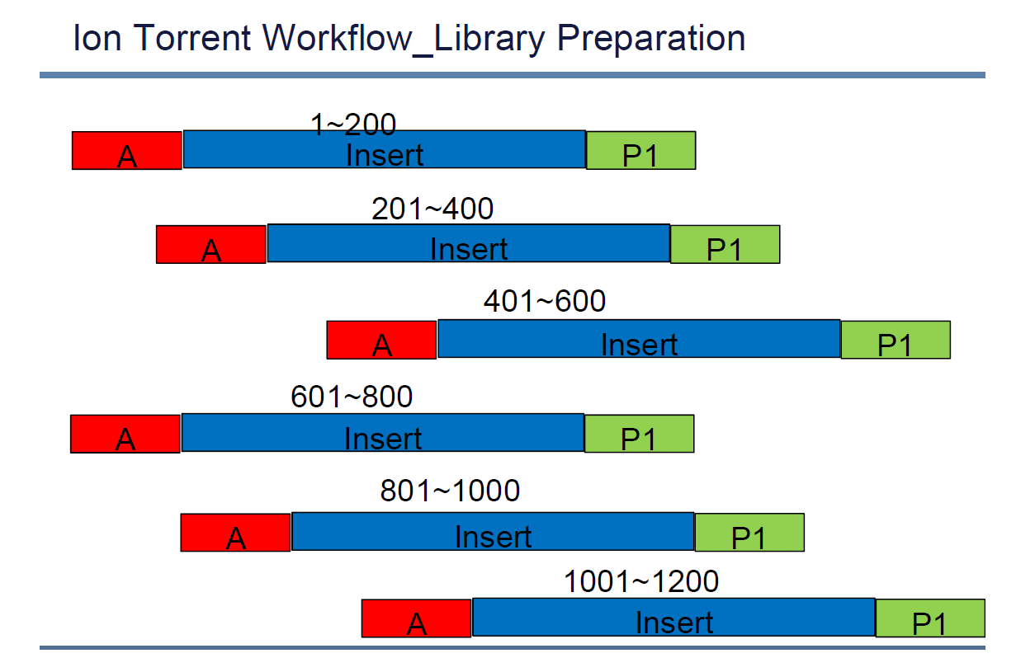

Slide 28
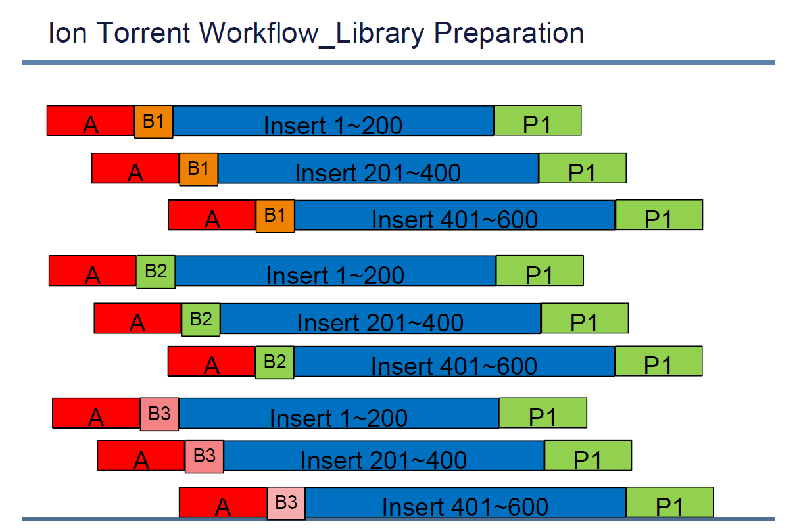

Slide 29
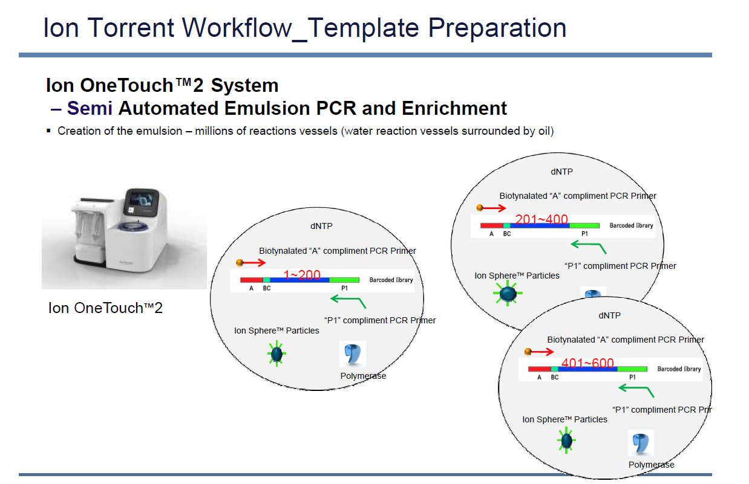

Slide 30
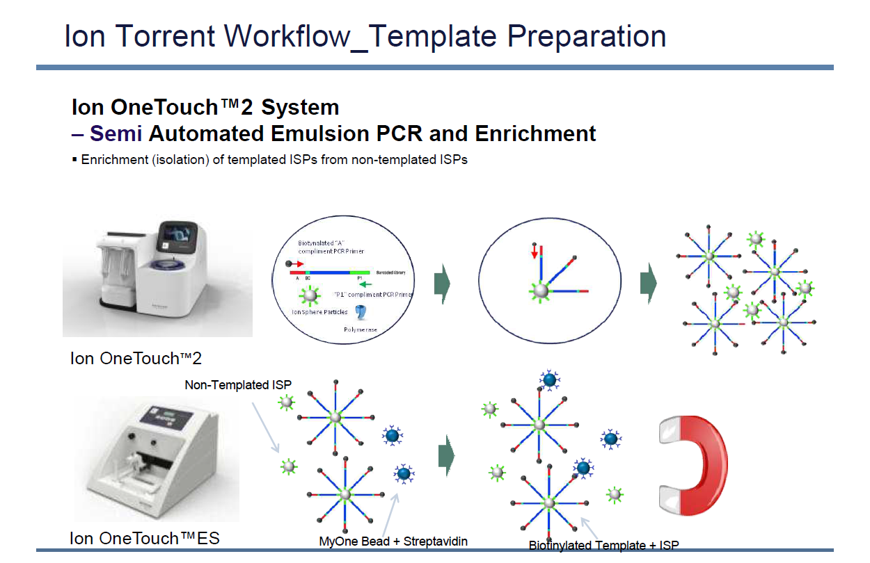

Slide 31
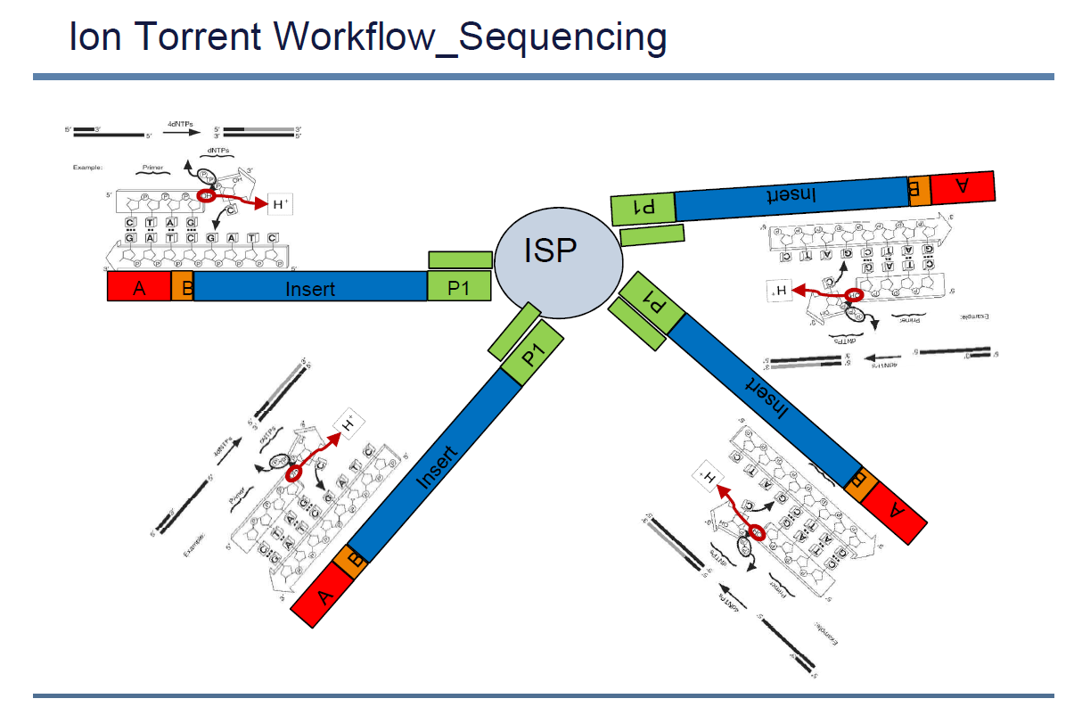

Slide 32
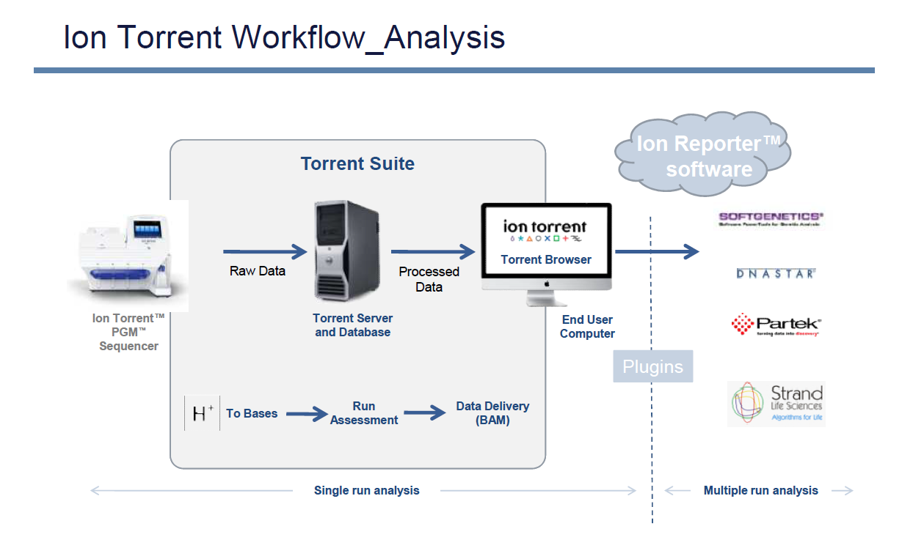

Slide 33
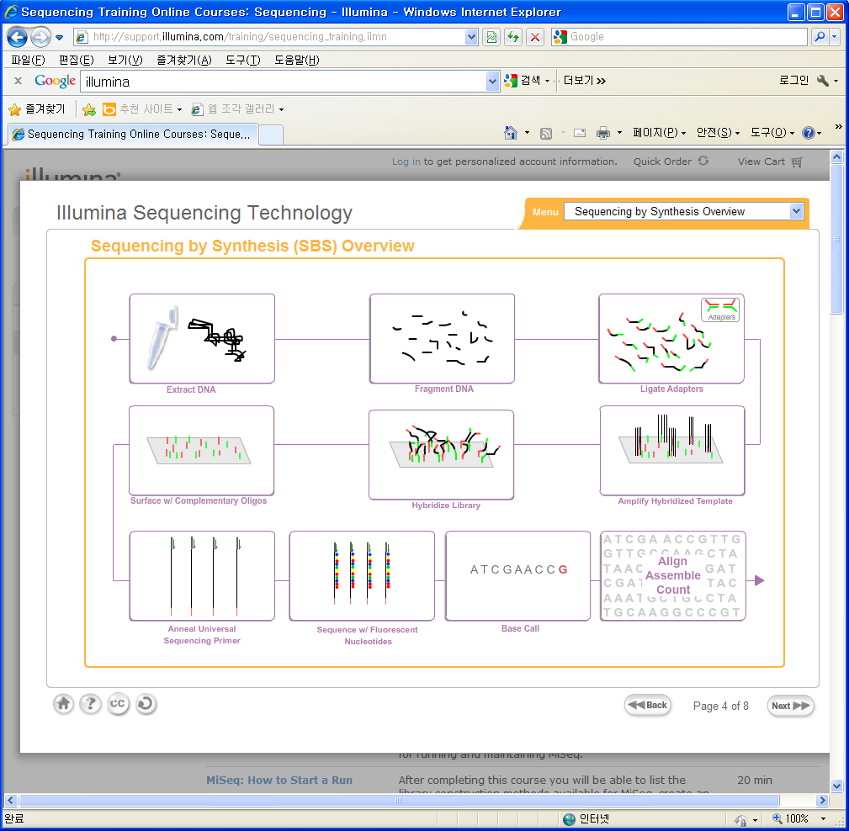
Illumina Workflow
http://support.illumina.com/training.ilmn

Slide 34
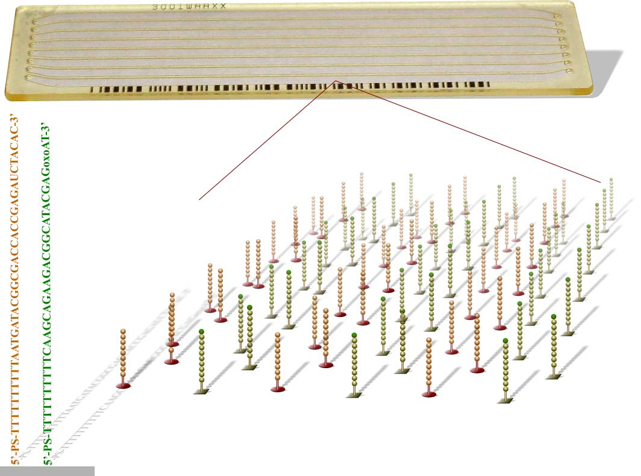
NGS Platform - HiSeq 2000
Flow Cell
34

Slide 35
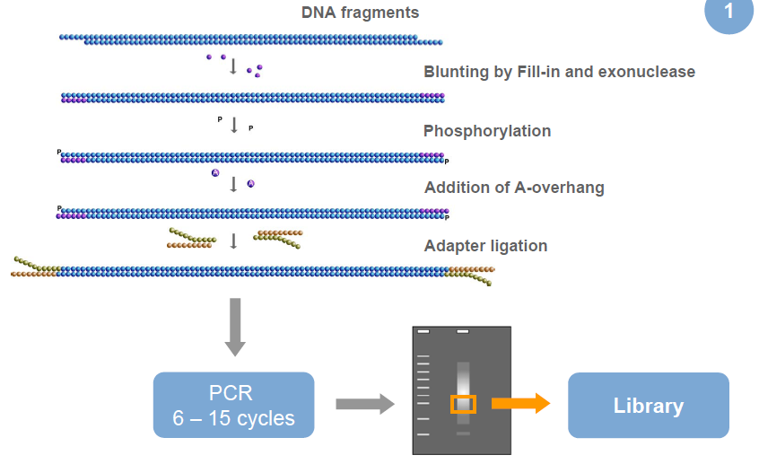
NGS Platform - HiSeq 2000
Genomic DNA Library Preparation
35

Slide 36
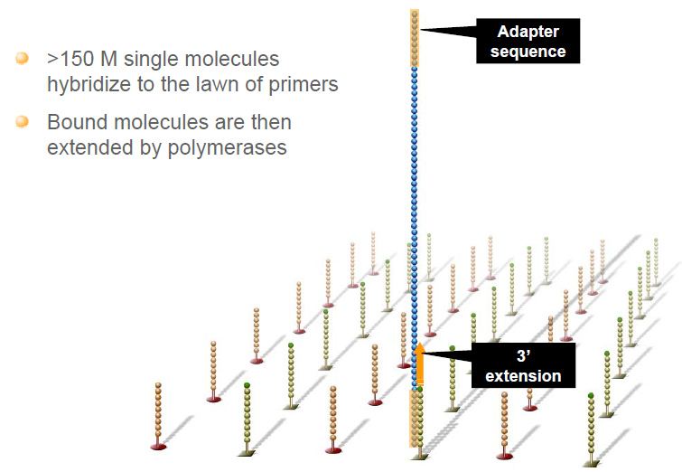
NGS Platform - HiSeq 2000
Cluster Generation - Hybridize fragment & Extend
36

Slide 37
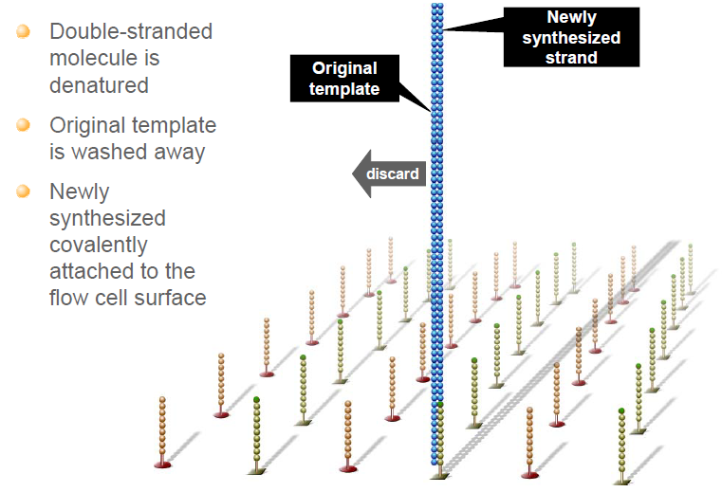
NGS Platform - HiSeq 2000
Cluster Generation – Denature Double stranded DNA
37

Slide 38
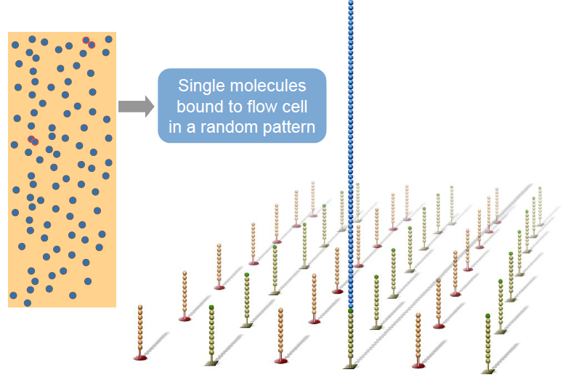
NGS Platform - HiSeq 2000
Cluster Generation – Covalently bound spatially separated single molecules
38

Slide 39
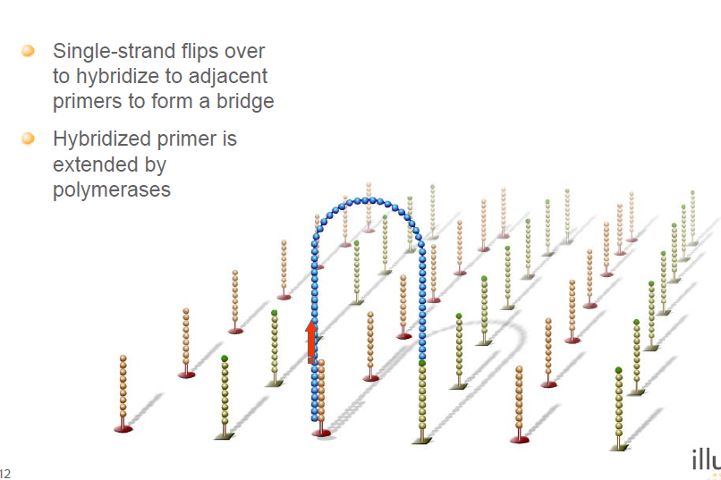
NGS Platform - HiSeq 2000
Cluster Generation – Bridge amplification
39

Slide 40
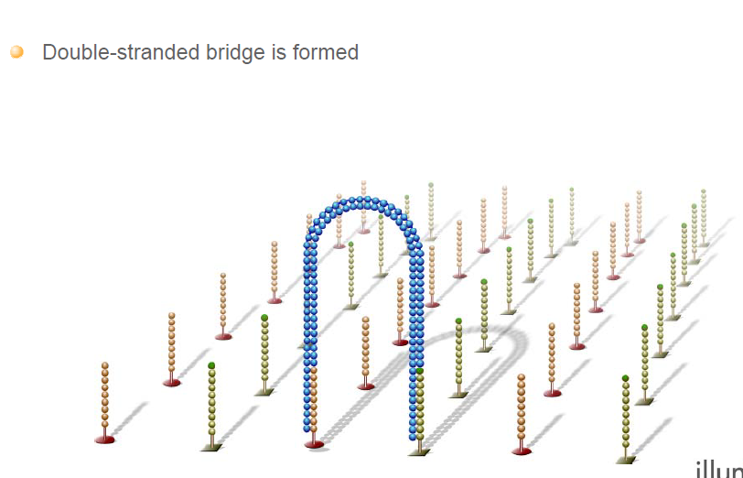
NGS Platform - HiSeq 2000
Cluster Generation – Bridge amplification
40

Slide 41
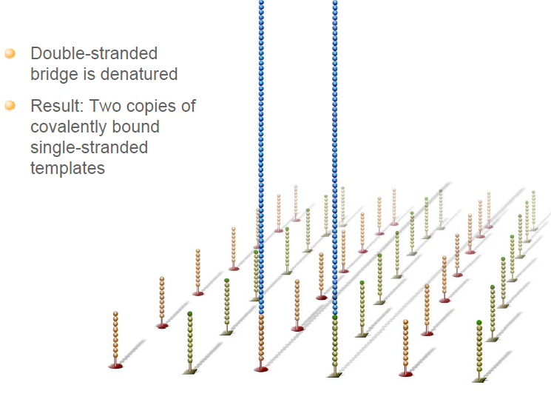
NGS Platform - HiSeq 2000
Cluster Generation – Bridge amplification
41

Slide 42
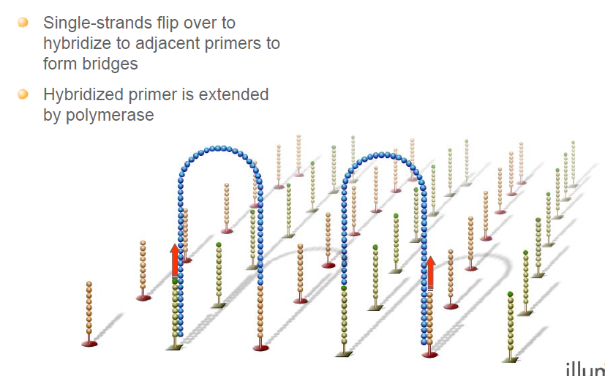
NGS Platform - HiSeq 2000
Cluster Generation – Bridge amplification
42

Slide 43
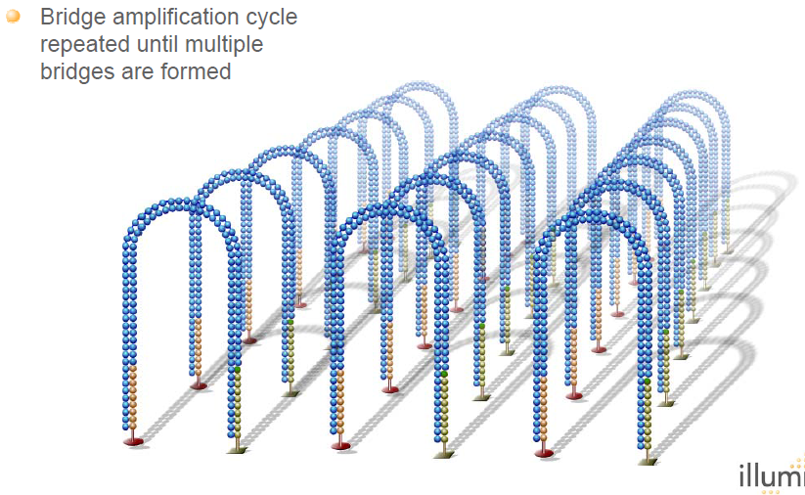
NGS Platform - HiSeq 2000
Cluster Generation – Bridge amplification
43

Slide 44
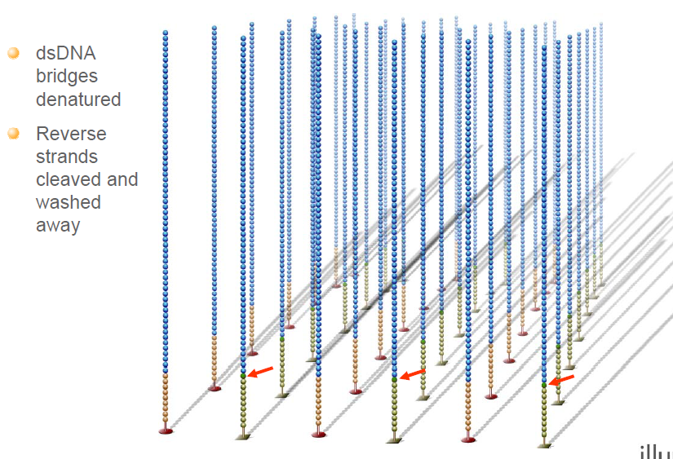
NGS Platform - HiSeq 2000
Cluster Generation
44

Slide 45
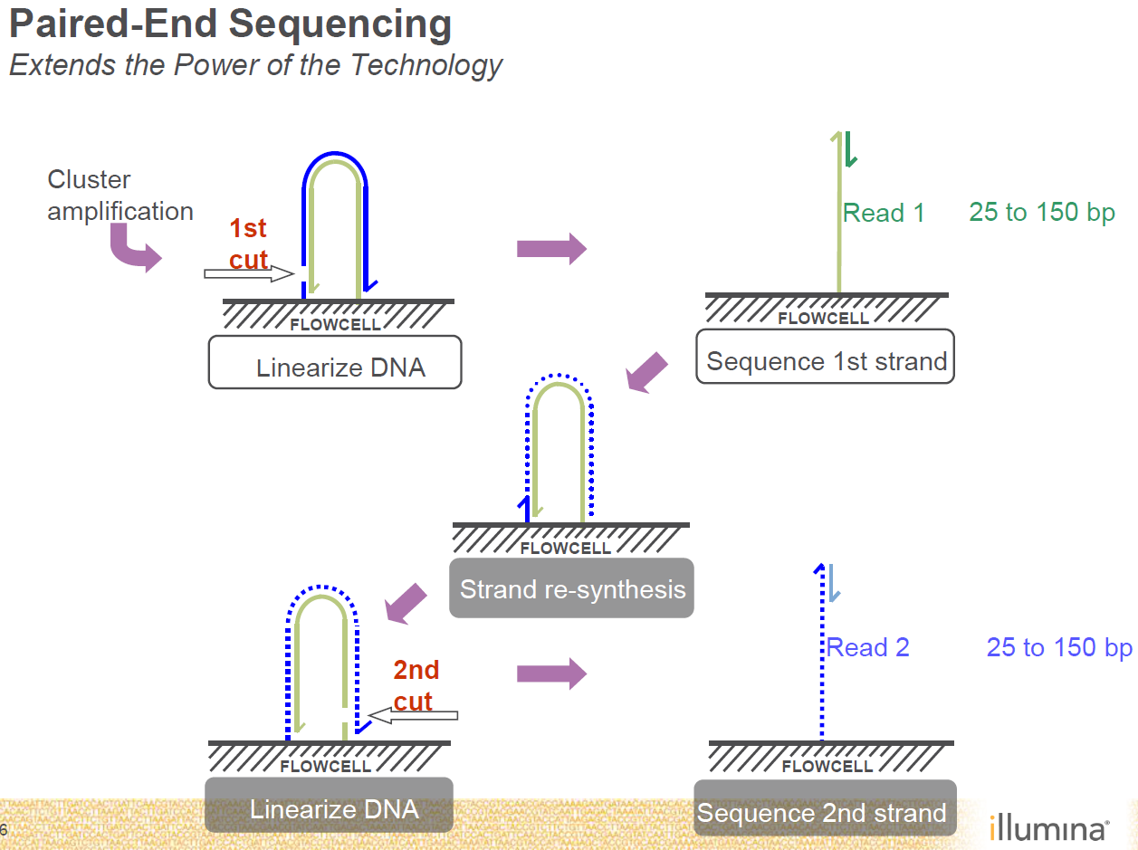

Slide 46
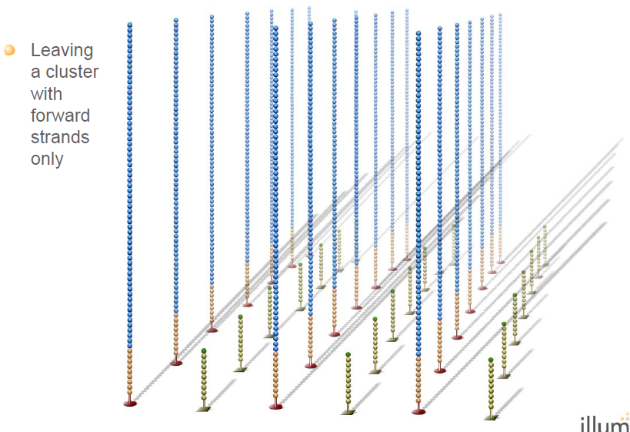
NGS Platform - HiSeq 2000
Cluster Generation
46

Slide 47


NGS Platform - HiSeq 2000
Genome analyzer sequencing reaction
47

Slide 48

NGS Platform - HiSeq 2000
Sequencing
48

Slide 49

NGS Platform - HiSeq 2000
Sequencing and Imaging
>3,000
49

Slide 50

NGS Platform - HiSeq 2000
Sequencing and Imaging
Tile
.
.
.
.
.
.
camera
Obj.
lens
FLOWCELL
8 channels/flow cell
X
2 columns/channel
X
50 tiles/column
X
4 images/tile
laser
PRISM
OIL
50

Slide 51

NGS Platform - HiSeq 2000
Sequencing and Imaging
51

Slide 52


Sequencing Procedure
Fluorecently labeled ‘modified’ ddNTP’s are added with a polymerase
A laser excites the flourophore
A camera captures the emission color
The fluorophore is cleaved off and the terminator is removed
Polymerase adds another base
Next cycle begins

Slide 53


Slide 54


Slide 55

HiSeq 2500 sequencing

Slide 56

HiSeq 2500 1T sequencing
v4
(Hiseq SBS kit v4)
(Hiseq rapid SBS kit V2)
v4
~1000 Gb (1 Tb)
2 X 125bp
~6-day run time
(2X250bp PE supported)

Slide 57

HiSeq 2500 1T sequencing

Slide 58

HiSeq 2500 1T High Output Run Mode

Slide 59
HiSeq 2500 1T Rapid Run Mode

Slide 60

Insert size: maximum 800bp, Maximum SE: up to 300bp SE

Slide 61


HiSeq 4000 sequencing

Slide 62

Hiseq X
Optimized for Population-Scale Human Genome Sequencing
➔ 18,000 Genomes Per Year

Slide 63

Hiseq X Performance

Slide 64

Genome Coverage per Lane

Slide 65


Slide 66


Slide 67

Dual Indexing adaptor sequece design
Truseq Universal Adapter for PE
5’-AATGA TACGG CGACC ACCGA GATCT ACACT CTTTC CCTAC ACGAC GCTCT TCCGA TCT-3’
TruSeq Adapter, Index 1 for PE
5’-CAAGC AGAAG ACGGC ATACG AGATC GTGAT GTGAC TGGAG TTCAG ACGTG TGCTC TTCCG ATC-3’
The oligo lawns are different for PE and SR flow cells, the PE ones are longer.
That is why you cannot run SR libraries on the PE flow cell.
For single read flowcell:
P5 5´-AATGA TACGG CGACC ACCGA-3´ P7 5´-CAAGC AGAAG ACGGC ATACG A-3´
For PE flow cell:
P5 5’-AATGA TACGG CGACC ACCGA GATCT ACAC-3‘ P7 5’-CAAGC AGAAG ACGGC ATACG AGAT-3’,

Slide 68

Dual-Indexed Sequencing Overview
I7 index sequencing은 8 cycles,
I5 index sequencing은 15 cycles (7cycles는 dark cycles, 나머지 8 cycles는 index sequencing)

Slide 69

Sequencing Primer Version Compatibility

Slide 70

Sequencing only order form

Slide 71

Multiplexing Considerations

Slide 72


Slide 73


Slide 74


Slide 75

Illumina DNA Sequencing Libraries

Slide 76

Illumina DNA Sequencing Libraries

Slide 77


Slide 78









Size Selection Method 정리
Dual Size Selection | E-gel | Manual gel elution
Beckman Coulter Double SPRI method (Shearing -> Size select) | Invitrogen Pre-cast gel 사용 (Adapter ligation->size select) | Traditional Gel electrophoresis (Adapter ligation->size select)

Slide 79
RNA/DNA - Size Selection Method 변경
 |  | Human WGS | Human WES-Tru | Non Human WGS | Human WES-SS | mRNA
Before |  | Dual size selection | Dual size selection | E-gel | NONE (protocol 그대로 사용) | E-gel
After | Default | Dual | Dual | Dual | No change | No size selection
 | Option | Insert 지정 library**
[논의해야 할 문제]
Dual Size Selection :
- 고객과 상담 시에는 Bead purification이라고 하는 것이 좋을 것으로 판단됨.
2. Insert 지정 library
-150~700bp 까지 가능, 3ug 필요 (dup% 줄이기 위함)하나 1.2ug으로 가능은 함.
-Defualt 대비 약 2만원의 추가 비용 발생함(인건비 포함)하므로 라이브러리 비용 차등화 필요
3. 변경 프로토콜 적용 시점
- Human DNA는 2013. 1월 부터 진행 중

Slide 80


Slide 81


Slide 82


Slide 83


Slide 84


Slide 85
Size Selection Method 정리
 | Dual Size Selection | E-gel | Manual gel elution
Handling | Easy | Moderate | Difficult
Automation | Yes | No | No
Sample #/1 batch | 96 | 72 (장비 필요) | 24
시약 비용(\) | 681 | 13,690 | 9,078
인건비(\)* | 4,687 | 6,250 | 18,750
Size range | Broad (500bp) | Sharp(200bp) | Flexible
Insert distribution | 정규분포 | Shoulder peak 존재 | 정규 분포이루지 않음
Reproducibilty | High | Low | Mid
Duplicate% | Low | High | Mid(100bp range지정한 경우)
Alignment% | Mid | High | High
권장 Application | Reseq. | - | De novo seq.

Slide 86


Slide 87


Slide 88



Slide 89


Slide 90


Slide 91


Slide 92


Slide 93


Slide 94


Slide 95


Slide 96


Slide 97



Slide 98


Slide 99


Slide 100


Slide 101


Slide 102


Slide 103


Slide 104


Slide 105


Slide 106

NGS 장비 스펙 비교
 | HiSeq2500 | PacBio RSII | PacBio Sequel | 10 X
장비가격 | $900K | $750K | $350K | $75,000
생산량 | 50, 63, 90Gb/lane | 1Gb/SMRTCell, 8 cells | 7Gb/SMRTCell, 16 cells | ~ 100 kb Average Length (1 ng gDNA) 적은 DNA 양으로 phasing, SNP, SV 가능 Haplotyping De novo sequencing 은 아직 개발 중
Read length | 100, 125, 150bp | 15~20kb | 15~20kb
run time(days) | 3.5d | 90min~12h | 90min~1d

